Slide 1
Matthew 28:16-20
You as Me
as He
你如我如他

Slide 2
Mt 28:16-20

Slide 3
The life-giving instruction of Mt 28:16-20:
The Great Commission is to make faithful, obedient little Christs of Christ.
大使命也就是要使人成為歸屬基督、對基督忠誠、順服的小基督。

Slide 4
Our Different #goals

Slide 5
Our Different #goals:
Our #goals gives us:
First, a destination.
With the destination, an imagination + motivation + direction (preparation) toward the destination.

Slide 6
Our Different #goals:
The power of our #goals is NOT just on an individual plane, but also communal i.e. It impacts not just the one who dreams, but those around him/ her

Slide 7
I have a dream that one day on the red hills of Georgia the sons of former slaves and the sons of former slave-owners will be able to sit down together at a table of brotherhood.
We will not be satisfied until justice rolls down like waters and righteousness like a mighty stream.
~Dr. Martin Luther King Jr.

Slide 8
We enjoy mixing up cocktails and an hors d’oeuvre or two, putting a little mood music on the phonograph and inviting in a female acquaintance for a quiet discussion on Picasso, Nietzsche, jazz, sex.
That I changed attitudes toward sex. That nice people can live together now. That I decontaminated the notion of premarital sex. That gives me great satisfaction.
~Mr. Hugh Hefner

Slide 9
Our Different #goals:
Who would you like to be as you grow up?
What would you like to do as you grow up?
What is the #goals that will give you a destination worth arriving in?
What is the #goals that will bring about the imagination, motivation and direction-preparation?

Slide 10
Jesus’ Grand #goals

Slide 11
Mt 28:18-20
18 Then Jesus came to them and said, “All authority in heaven and on earth has been given to me. 19 Therefore go and make disciples of all nations, baptizing them in the name of the Father and of the Son and of the Holy Spirit, 20 and teaching to obey everything I have commanded you. And surely I am with you always, to the very end of the age.”

Slide 12
Mt 28:18-20
18耶 穌 進 前 來 ， 對 他 們 說 ： 天 上 地 下 所 有 的 權 柄 都 賜 給 我 了 。19所 以 ， 你 們 要 去 ， 使 萬 民 作 我 的 門 徒 ， 奉 父 、 子 、 聖 靈 的 名 給 他 們 施 洗 （ 或 作 ： 給 他 們 施 洗 ， 歸 於 父 、 子 、 聖 靈 的 名 ） 。20 凡 我 所 吩 咐 你 們 的 ， 都 教 訓 他 們 遵 守 ， 我 就 常 與 你 們 同 在 ， 直 到 世 界 的 末 了 。

Slide 13
Mt 1:1
This is the genealogy of Jesus Christ the son of David, the son of Abraham…
亞 伯 拉 罕 的 後 裔 ， 大 衛 的 子 孫 （ 後 裔 子 孫 原 文 都 作 兒 子 下 同 ） ， 耶 穌 基 督 的 家 譜…

Slide 14
Jesus’ Grand #goals:
Intentional closing: Geography
___Mountain

Slide 15
Jesus’ Grand #goals:
Intentional closing: Geography
___Mountain
___Galilee

Slide 16
Jesus’ Grand #goals:
Intentional closing: Jesus’ words (vv. 18-20)
___There is a King < > “I am the King”

Slide 17
Jesus’ Grand #goals:
Intentional closing: Jesus’ words (vv. 18-20)
___There is a King < > “I am the King”
___There are the citizens of the Kingdom < > “You repentant ones are the citizens”
→ Faithful, Obedient; MADE (imperative)

Slide 18
Jesus’ Grand #goals:
Intentional closing: Jesus’ words (vv. 18-20)
___There is a King < > “I am the King”
___There are the citizens of the Kingdom < > “You repentant ones are the citizens”
→ Faithful, Obedient; MADE (imperative)
___There is the King who is ever present with His citizens

Slide 19
Our Grand Reality

Slide 20
Our Grand Reality:
We who are disciples of Jesus are the living Mt 28:18-20!
What Jesus first spoke of as the grand prescription and description of God’s Kingdom has become and is already OUR GRAND REALITY now!

Slide 21
Mt 6:31-33
So do not worry, saying, ‘What shall we eat?’ or ‘What shall we drink?’ or ‘What shall we wear?’ For the pagans run after all these things, and your heavenly Father knows that you need them. But seek first his kingdom and his righteousness, and all these things will be given to you as well.
所 以 ， 不 要 憂 慮 說 ： 吃 甚 麼 ？ 喝 甚 麼 ？ 穿 甚 麼 ？這 都 是 外 邦 人 所 求 的 ， 你 們 需 用 的 這 一 切 東 西 ， 你 們 的 天 父 是 知 道 的 。你 們 要 先 求 他 的 國 和 他 的 義 ， 這 些 東 西 都 要 加 給 你 們 了 。

Slide 22
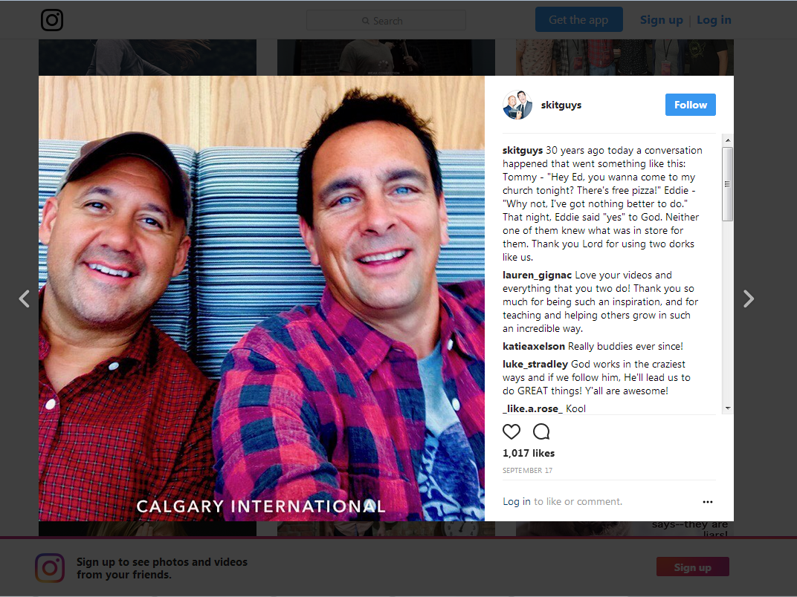
IG: @skitguys

Slide 23
Our Grand Reality:
(Though with hesitancy)
BUT when with faith and obedience, we know what we are to do exactly: Do as Jesus the Christ said to do.

Slide 24
Remarkably, Jesus does not foresee a time when any part of his teaching will be rightly judged needless, outmoded, superseded, or untrue. Everything he has commanded must be passed on “to the very end of the age.”
~Michael J. Wilkins

Slide 25
Our Grand Reality:
What now will be the message the way you and I live proclaim? (Against the many other #goals that the World has to offer)

Slide 26
Our Grand Reality:
Ultimately, WHO WILL THEY SEE AS WORHTY OF WORSHIP!?

