Slide 1
Total Redemption
For the Totally Rotten
全然的救贖
給那全然墮落的

Slide 2
Not So Cutesy
After All

Slide 3
Wikipedia

Slide 4
Not So Cutesy After All:
Yet… what are some of these values that are therefore welcomed openly into our homes, into our consciousness, shaping our conscience?

Slide 5
If we do not think in terms of measured appropriation, biblical evaluation, and thoughtful transformation, we will probably be consumed by culture, and won’t even know that we are more American than we are Christian.
~Pastor John Piper, Don’t Waste Your Life

Slide 6
Not So Cutesy After All:
Somehow, the Holy Spirit doesn’t usually get the invitation, does he?

Slide 7
‘s
Beauty and the Beast

Slide 8
Disney’s Beauty and the Beast:
Opening sequence - https://www.youtube.com/watch?v=7fEbW568CZo

Slide 9
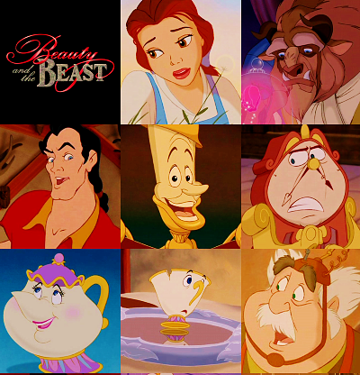
54disneyreviews.com

Slide 10
Not So Beautiful
After All

Slide 11
Not So Beautiful After All:
(Humanistic Moralism)
We are presented two general types of humanity: The good people and the less than good, even bad, people

Slide 12
Not So Beautiful After All:
Humanistic: the individual (ME) is the most important, perception is removed of any divine/ supernatural association and intervention, assumed to have a prepackaged goodness that just needs to be “unpacked”

Slide 13
Not So Beautiful After All:
Moralism: Still a matter of good and bad

Slide 14
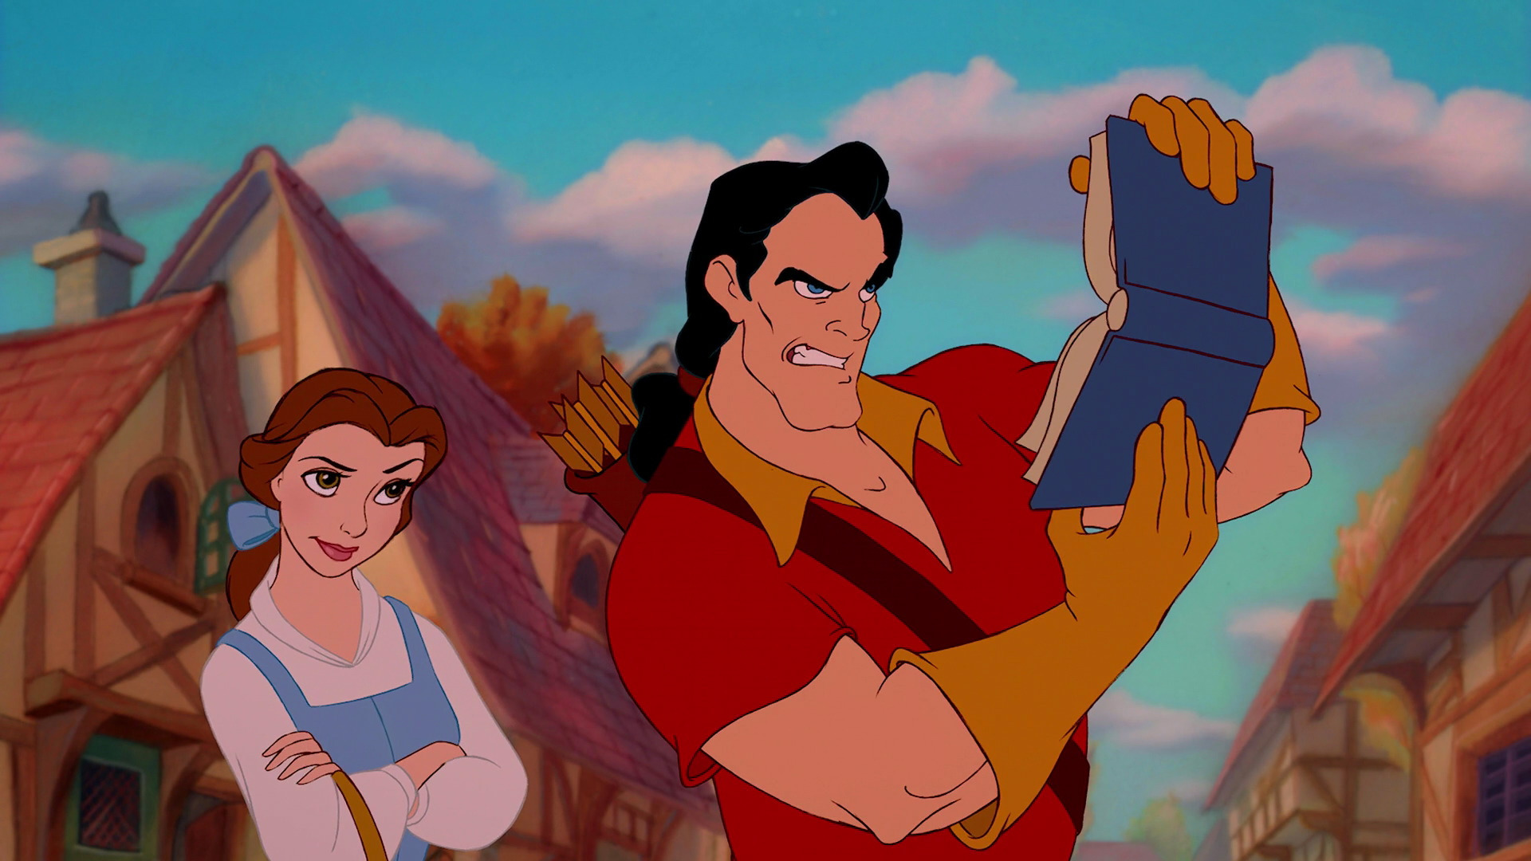
Not So Beautiful After All:
Why is it that Gaston is obnoxious and a bad taste while Belle is so swoon worthy despite her self-righteousness?

Slide 15
Not So Beautiful After All:
Fundamentally, it (humanistic moralism) clicks well with what we hear and desire so much:
I AM A GOOD PERSON + I am a better person than at least some of YOU

Slide 16
Not So Beautiful After All:
And when it is not the Disney version but the Christian/ Church version, it is called Moralistic Therapeutic Deism 道德治療性神本主義

Slide 17
Not So Beautiful After All:
God is my physical trainer, my financial planner, my home builder, my solution provider, my sins forgiver, my career maker, my grade saver… BUT never quite my LORD, my MAKER

Slide 18
Not So Beautiful After All:
Do we think and live as if God’s primary care toward us is our happiness and NOT our holiness?

Slide 19
Not So Beautiful After All:
GOD’S GRACE IS NEVER ABSOLUTELY PRECIOUS BECAUSE WE DO NEVER REGARD OURSELVES AS ABSOLUTELY UNDERSERVING.
CHRIST’S REDEMPTION IS NEVER TOTAL BECAUSE WE NEVER ACKNOWLEDGE OURSELVES TO BE TOTALLY ROTTEN.

Slide 20
Ezek 18: 32
For I take no pleasure in the death of anyone, declares the Sovereign Lord. Repent and live!
主 耶 和 華 說 ： 我 不 喜 悅 那 死 人 之 死 ， 所 以 你 們 當 回 頭 而 存 活 。

Slide 21
Ezek 36: 26-27
I will give you a new heart and put a new spirit in you; I will remove from you your heart of stone and give you a heart of flesh. And I will put my Spirit in you and move you to follow my decrees and be careful to keep my laws.
我 也 要 赐 给 你 们 一 个 新 心 ， 将 新 灵 放 在 你 们 里 面 ， 又 从 你 们 的 肉 体 中 除 掉 石 心 ， 赐 给 你 们 肉 心 。我 必 将 我 的 灵 放 在 你 们 里 面 ， 使 你 们 顺 从 我 的 律 例 ， 谨 守 遵 行 我 的 典 章 。

Slide 22
The Prince Who Became the Beast

Slide 23
Rom 5: 6-8
⁶ You see, at just the right time, when we were still powerless, Christ died for the ungodly. ⁷ Very rarely will anyone die for a righteous person, though for a good person someone might possibly dare to die. ⁸ But God demonstrates his own love for us in this: While we were still sinners, Christ died for us.

Slide 24
Rom 5: 6-8
⁶ 因 我 們 還 軟 弱 的 時 候 ， 基 督 就 按 所 定 的 日 期 為 罪 人 死 。⁷ 為 義 人 死 ， 是 少 有 的 ； 為 仁 人 死 、 或 者 有 敢 做 的 。⁸ 惟 有 基 督 在 我 們 還 作 罪 人 的 時 候 為 我 們 死 ， 神 的 愛 就 在 此 向 我 們 顯 明 了 。

Slide 25
Isa 52: 14
Just as there were many who were appalled at him— his appearance was so disfigured beyond that of any human being and his form marred beyond human likeness.
許 多 人 因 他 驚 奇 ； 他 的 面 貌 比 別 人 憔 悴 ； 他 的 形 容 比 世 人 枯 槁 。

Slide 26
1 Jn 4: 10, 19
This is love: not that we loved God, but that he loved us and sent his Son as an atoning sacrifice for our sins. We love because he first loved us.
不 是 我 們 愛 神 ， 乃 是 神 愛 我 們 ， 差 他 的 兒 子 為 我 們 的 罪 作 了 挽 回 祭 ， 這 就 是 愛 了 。 我 們 愛 ， 因 為 神 先 愛 我 們 。

Slide 27
Jn 13: 34; 14: 21
A new command I give you: Love one another. As I have loved you, so you must love one another. Whoever has my commands and keeps them is the one who loves me. The one who loves me will be loved by my Father, and I too will love them and show myself to them.
我 賜 給 你 們 一 條 新 命 令 ， 乃 是 叫 你 們 彼 此 相 愛 ； 我 怎 樣 愛 你 們 ， 你 們 也 要 怎 樣 相 愛 。 有 了 我 的 命 令 又 遵 守 的 ， 這 人 就 是 愛 我 的 ； 愛 我 的 必 蒙 我 父 愛 他 ， 我 也 要 愛 他 ， 並 且 要 向 他 顯 現 。

Slide 28
EVIL
LIVE

