Slide 1
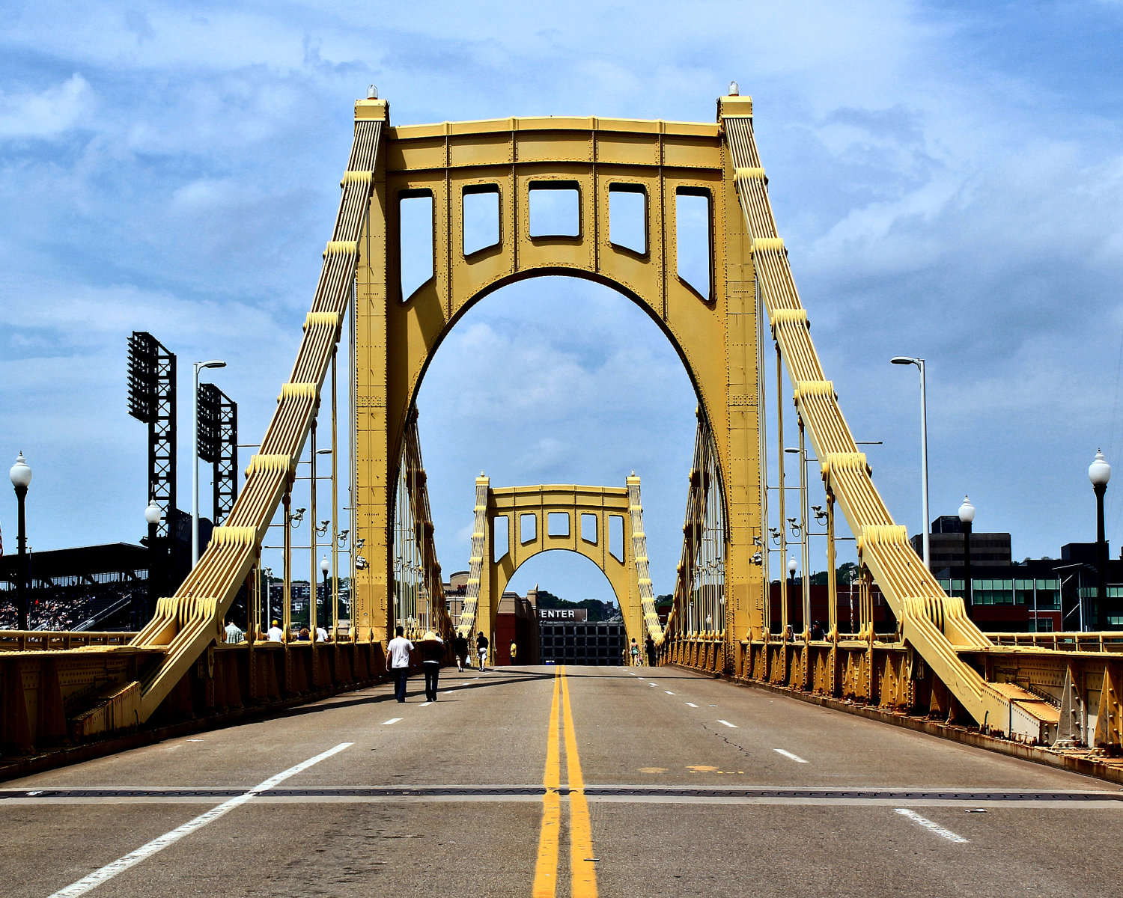
&
Being Bridges!
Breaking Barriers!

Slide 2
Making some observations from Acts 8, 9, and 10: 1. Philip to Eunuch (8:26-40) 2. Ananias to Saul (9:10-18) 3. Peter to Cornelius (10:1-48) Three back to back stories about God sending someone to be a “bridge” of His Gospel!

Slide 3
Making some observations from Acts 8, 9, and 10: 1. Philip to Eunuch (8:26-40) 2. Ananias to Saul (9:10-18) 3. Peter to Cornelius (10:1-48) Questions: How did Philip get there? Who spoke to Ananias? Who spoke to Cornelius?

Slide 4
Making some observations from Acts 8, 9, and 10: 1. Philip to Eunuch (8:26-40) 2. Ananias to Saul (9:10-18) 3. Peter to Cornelius (10:1-48) Question: Who can do a better job at sharing the Gospel- you and me, or angels, Jesus, and he Holy Spirit?

Slide 5
Making some observations from Acts 8, 9, and 10: 1. Philip to Eunuch (8:26-40) 2. Ananias to Saul (9:10-18) 3. Peter to Cornelius (10:1-48) Question: Why does God want to add this “extra step” to use us?

Slide 6
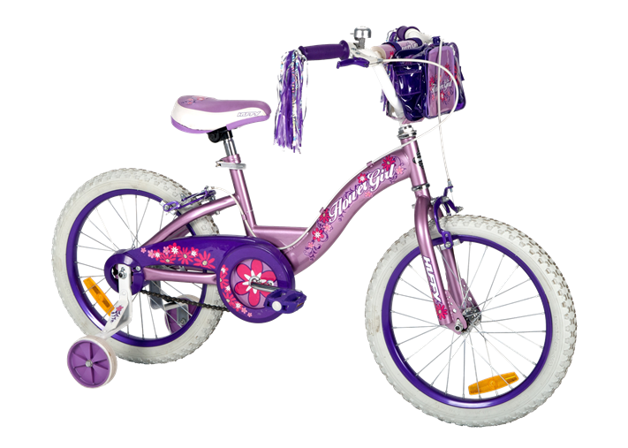
God’s gracious & loving offer of partnership for eternal matters!

Slide 7
Making some observations from Acts 8, 9, and 10: 1. Philip to Eunuch (8:26-40) 2. Ananias to Saul (9:10-18) 3. Peter to Cornelius (10:1-48) Question: What barriers did each of the “bridge person” have to breakthrough to be used by God?

Slide 8
Making some observations from Acts 8, 9, and 10: 1. Philip > Success 2. Ananias > Fear 3. Peter > Prejudice Question: What barriers did each of the “bridge person” have to breakthrough to be used by God?

Slide 9
Making some observations from Acts 8, 9, and 10: 1. Philip > Success 2. Ananias > Fear 3. Peter > Prejudice Question: Who is God asking you to be a bridge to right where you are?

Slide 10
Making some observations from Acts 8, 9, and 10: 1. Philip > Success 2. Ananias > Fear 3. Peter > Prejudice Question: What barriers are there that you must breakthrough with God’s help?

Slide 11
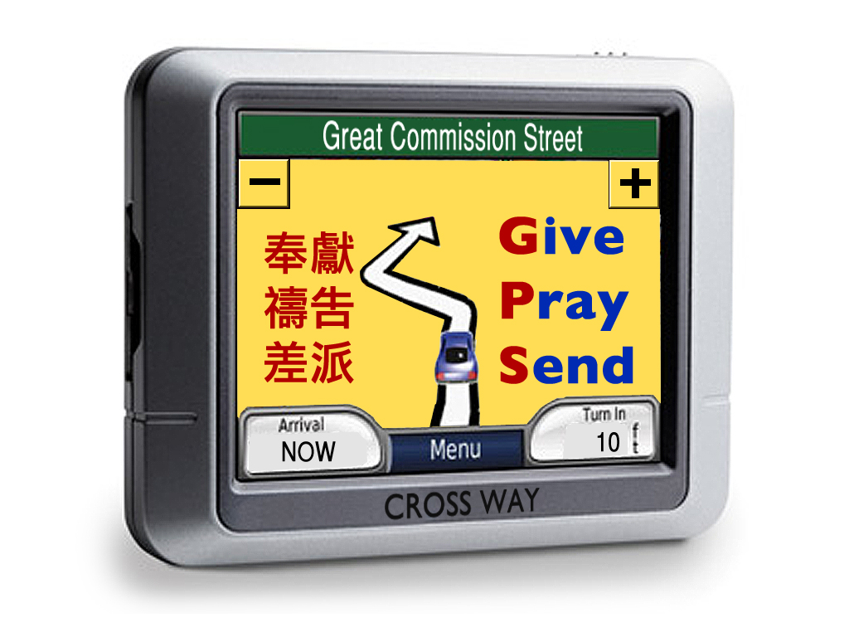
Question: How can you be a “gospel bridge” to people in other parts of the world?

Slide 12
&
Being Bridges!
Breaking Barriers!

