Slide 1
Abath in the
Sabbath
沐浴在安息中

Slide 2
Gen 1: 31- 2: 3
31 God saw all that He had made, and it was very good. And there was evening, and there was morning – the sixth day. 1 Thus the heavens and the earth were completed in all their vast array. 2 By the seventh day God had finished the work He had been doing; so on the seventh day He rested from all His work. 3 Then God blessed the seventh day and made it holy, because on it He rested from all the work of creating that He had done.

Slide 3
Gen 1: 31- 2: 3
³¹ 神 看 著 一 切 所 造 的 都 甚 好 。 有 晚 上 ， 有 早 晨 ， 是 第 六 日 。 ¹ 天 地 萬 物 都 造 齊 了 。² 到 第 七 日 ， 神 造 物 的 工 已 經 完 畢 ， 就 在 第 七 日 歇 了 他 一 切 的 工 ， 安 息 了 。 ³ 神 賜 福 給 第 七 日 ， 定 為 聖 日 ； 因 為 在 這 日 ， 神 歇 了 他 一 切 創 造 的 工 ， 就 安 息 了 。

Slide 4
Heb 4: 9-13
9 There remains, then, a Sabbath-rest for the people of God; 10 for anyone who enters God’s rest also rests from their works, just as God did from His. 11 Let us, therefore, make every effort to enter that rest, so that no one will perish by following their example of disobedience.

Slide 5
Heb 4: 9-13
12 For the word of God is alive and active. Sharper than any double-edged sword, it penetrates even to dividing soul and spirit, joints and marrow; it judges the thoughts and attitudes of the heart. 13 Nothing in all creation is hidden from God’s sight. Everything is uncovered and laid bare before the eyes of Him to whom we must give account.

Slide 6
Heb 4: 9-13
⁹ 這 樣 看 來 ， 必 另 有 一 安 息 日 的 安 息 為 神 的 子 民 存 留 。¹⁰ 因 為 那 進 入 安 息 的 ， 乃 是 歇 了 自 己 的 工 ， 正 如 神 歇 了 他 的 工 一 樣 。¹¹ 所 以 ， 我 們 務 必 竭 力 進 入 那 安 息 ， 免 得 有 人 學 那 不 信 從 的 樣 子 跌 倒 了 。

Slide 7
Heb 4: 9-13
¹² 神 的 道 是 活 潑 的 ， 是 有 功 效 的 ， 比 一 切 兩 刃 的 劍 更 快 ， 甚 至 魂 與 靈 ， 骨 節 與 骨 髓 ， 都 能 刺 入 、 剖 開 ， 連 心 中 的 思 念 和 主 意 都 能 辨 明 。¹³ 並 且 被 造 的 沒 有 一 樣 在 他 面 前 不 顯 然 的 ； 原 來 萬 物 在 那 與 我 們 有 關 係 的 主 眼 前 ， 都 是 赤 露 敞 開 的 。

Slide 8
Instruction:
In any sabbath, we are shaped to be God-minded and God-dependent people.
在任何的安息中，我們被塑造為以神為主、仰賴上帝的人。

Slide 9
In the Midst of Haunting Stillness

Slide 10
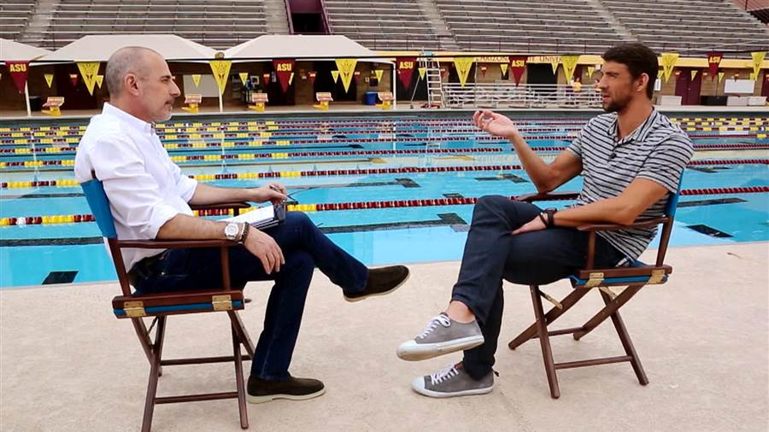
http://www.today.com/news/michael-phelps-talks-rio-rehab-retirement-today-s-matt-lauer-t88666

Slide 11
In the Midst of Haunting Stillness:
In that stillness, we are asked those potentially frightful questions of IDENTITY and MEANING: Who are you, REALLY? What is your purpose in life, REALLY?

Slide 12
In the Midst of Haunting Stillness:
If I am no longer doing anything, what do I have to validate my existence, my merit?

Slide 13
In the Midst of Haunting Stillness:
And many have banked their redemption on achieving great, accomplishing much, performing flawlessly, possessing plenty, and may I add, be super well-liked by as many as possible.

Slide 14
In the Midst of
Holy Stillness

Slide 15
In the Midst of Holy Stillness:
(Gen 2: 3) Not only did God rest, but He also made this day when He rested HOLY i.e. He called particular attention to this day when He ceased from His creative work, marked it out to give it His blessing

Slide 16
In the Midst of Holy Stillness:
(Gen 1: 31) Why did God “Sabbath”? He was in FULL CONTENTMENT of His creative creation work (NOT that He was tired!)

Slide 17
In the Midst of Holy Stillness:
Humanity was made by God for deep communion with God (Gen 1: 26-28; 3: 8-9), appraised by God (Gen 1: 31), and appointed by God for good work (Gen 1: 26-28; 2: 15).

Slide 18
In the Midst of Holy Stillness:
In being part of the completed created order, humanity is then not tasked to ADD ON to what God has created, but to ENJOY His created work. In other words, to be CONTENTED in the work God has done.

Slide 19
In the Midst of Holy Stillness:
(Gen 3: 17-19) It was sin that was birthed out of our pride to want to be God that turned pleasurable work into belaboring toil.

Slide 20
In a world where everyone’s deity says to do, do, do, the God of Israel says to stop. The air we breathe of this fallen world is anxiety: Keep busy and stay nervous. And it’s into this mess, striking through the smog like flashes of lightening, the fundamental message of God’s salvation resounds: Trust me and rest.
~Jonathan Parnell

Slide 21
In the Midst of Holy Stillness:
Why? SO THAT THEY AGAIN WILL KNOW GOD AND TO WORSHIP HIM ALONE.

Slide 22
Exo 20: 2
I am the LORD your God, who brought you out of Egypt, out of the land of slavery.
我 是 耶 和 華 ─ 你 的 神 ， 曾 將 你 從 埃 及 地 為 奴 之 家 領 出 來 。

Slide 23
In the Midst of Holy Stillness:
I am UNLIKE your oppressive, self-seeking slave masters of old BUT Your true Lord who loves you, is faithful to you, is passionate about you, who has placed My image IN YOU, and in whom you are freed to live a wholly, holy life.

Slide 24
Jn 19: 30
It is finished.
成 了！

Slide 25
We risk living soul-exhausted lives, and wondering why God isn’t more real to us, why we’re exhausted and grumpy.
~Ray Ortlund

Slide 26
Jn 19: 30
See what great love the Father has lavished on us, that we should be called children of God! And that is what we are! The reason the world does not know us is that it did not know him.
你 看 父 賜 給 我 們 是 何 等 的 慈 愛 ， 使 我 們 得 稱 為 神 的 兒 女 ； 我 們 也 真 是 他 的 兒 女 。 世 人 所 以 不 認 識 我 們 ， 是 因 未 曾 認 識 他 。

Slide 27
In the Midst of Holy Stillness:
In the place of that toxic chain (of achieving great, accomplishing much, performing flawlessly, possessing plenty, be super well-liked by as many as possible), we find the loving, forgiving hands of JC who will take us through all of life’s journey from now till that final, lively Sabbath-rest in God.

Slide 28
In the Midst of Holy Stillness:
Let “all the theology” sink deep into our consciousness.
Build up the discipline of the sabbath from “all the theology” that now permeates our consciousness.

Slide 29
In the Midst of Holy Stillness:
Ask: How is this hour/ day/ week/ month/ year any different (made holy) than other hours/ days/ weeks/ months/ years?

